Slide 1
Software Engineering
Introduction
Dr. Adeel Ansari

Slide 2
About the Instructor - Dr. Adeel Ansari
Assistant Professor, Computer Science Department
Email: adeel.ansari@szabist.pk
Office location: Room 301, SZABIST 100 Campus
Research areas of interest: Software Engineering, Artificial Intelligence, Generative AI, Explainability AI (XAI), Machine Learning and Data Modelling.
LinkedIn: https://www.linkedin.com/in/dr-adeel-ansari/
Educational Background:
PhD in IT, University Technology PETRONAS, Malaysia, 2016
MS Software Engineering, PAF-KIET, Pakistan, 2011
MBA (MIS), PAF-KIET, Pakistan, 2008
BSc(Hons) in Computing, Staffordshire University, UK

Slide 3
My Schedule for the Fall Semester 2023
Monday: Class of Sec C from 11:30 till 2:45 pm.
Tuesday: Class of Sec B from 11:30 till 2:45 pm.
Wednesday: Class of Sec E from 11:30 till 2:45 pm.
Friday: Class of Sec D from 9:45 till 1:00 pm.
I will be coming to campus all five days ( Monday to Friday), but it is better to schedule an appointment before meeting.
Thursday is a good day for a discussion!

Slide 4
Google Classroom Section-wise Codes
Join your respective Section immediately and confirm!
Sec B: xckathm
Sec C: niqjd2j
Sec D: 6wlwqdn
Sec E: pgianat

Slide 5
Relevant Text Books and Material
Course Outline already posted on ZABDESK and GCR!
Text Book
Software Engineering A Practitioners Approach , Roger Pressman., 9th Edition, McGraw-Hill Education,2020.
Reference Books
1 | Applying UML and Patterns: An Introduction to Object Oriented Analysis and Design and Iterative Development, Craig Larman, 2nd Edition, ,2012.
2 | Fundamentals of Software Engineering, Rajat Gupta, 1st Edition, ,2019.
3 | Modern Software Engineering, David Farley, 1st Edition, Addison-Wesley Professional,2021.

Slide 6
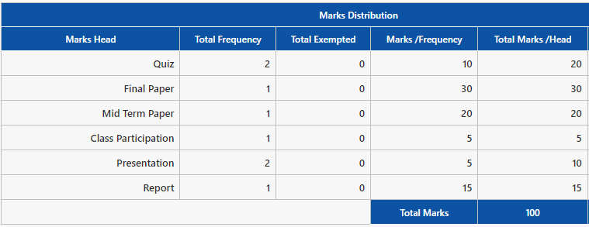
Course Assessment - RECAP SHEET
Report will be a group effort of maximum 4 students.
You can work over an actual project for a company or can do a research study over a certain topic.
Presentations are based over the report work. PPT 1 is on the 6th Week and PPT 2 is on the last week with report submission.

Slide 7
Lastly, who will be the CR!

Slide 8
What is “SOFTWARE ENGINEERING” all about?
Finding out the problem? Is it the Product? or the Process?
What is or capturing the purpose of the system.
Who are the stakeholders, who will get impacted? Or who will benefit from it?
Set of techniques to gather requirements.
Documentation and Conflict resolutions within teams and clients over requirements.
Consequences of failure? R-C-T triad.
Increasing trust over the system.

Slide 9
Description of the course
Analysis and specification of functional and non-functional requirements for real-time and non-real-time software systems
Learn the use of Computer-Aided Software Engineering (CASE) tools to illustrate analysis concepts
Represent the real-world needs of users, customers, and other stakeholders that will be affected by the software system,
Require the creation of a precise description of what the system should and should not do along with any constraints on its operation and implementation,

Slide 10
This course will cover?
The course will introduce the basics of software engineering.
It will discuss the issues, processes, and techniques in requirements engineering.
The course will teach different modeling approaches in problem solving.
It will introduce advance and potential research topics in software engineering.

Slide 11
Terminologies you will hear!
Feasibility Study of the system
Stakeholder analysis
Risk Analysis
Elicitation Techniques
System Requirement Specification (SRS)
NFR -> Non-functional requirements
GQM – Goal Question Matrix

Slide 12
Main Topics of this Course
Software Process Models
Software Agile Process
Human Aspects of Software Engineering
Software Requirement Engineering
Requirement Modelling and Validation
Design Patterns
UI/ UX Designs
Software Quality Assurance
Software Testing
Software Project Management
Software Risk Management
AI and Software Engineering

Slide 13
Week | Topic | Description
1 | Overview of Software Engineering [Chapter 1] | Application Domains Failure Curve Framework Activities Umbrella Activities Software Wear and Evolution
2 | The Software Process Model [Chapter 2] | Prescriptive Process Models -Waterfall, Prototyping, Evolutionary and Unified Models
3 | Software Agile Process [Chapter 3] | The Agile Process Scrum -Scrum Teams and Artifacts -Scrum Planning and Meeting -Daily Scrum Meeting -Sprint Review Meeting -Sprint Retrospective Other Agile Frameworks -XP Framework -Kanban -DevOps
4 | Human Aspects of Software Engineering [Chapter 5] | Characteristics of a Software Engineer The Software Team Team Structures Impact of Social Media Global Teams
5 | Software Requirement Engineering [Chapter 7] | Types of Requirements. Software Requirement Life Cycle Requirement Modelling Software Requirement Specification
6 | Software Requirement Engineering [Chapter 7] | Identifying Stakeholders Elicitation Techniques Developing Use Cases Data Flow Diagrams -Context Diagram -Level 0 Diagram
7 | Requirement Modeling and Validation [Chp 7 & 8] | Negotiating Requirements Requirement Monitoring Validating Requirements Scenario-Based Modelling Class-Based Modelling

Slide 14
8 | Midterm Week | Midterm Week
9 | Functional Modelling, Behavioral Modelling [Chapter 8] | UML Sequence Diagrams UML State Diagrams UML Activity Diagrams
10 | Design Concepts [Chapter 9] | Design Concepts -Abstraction -Patterns -Separation of Concerns -Modularity -Information Hiding -Refactoring -Design Classes The Design Model -Interface Design Elements -Component-Level Design Elements -Deployment-Level Design Elements
11 | User Experience Design [Chapter 12] Pattern-Based Design [Chapter 14] | [From Chapter 12] User Experience Analysis -User Research -User Modelling -Task Analysis -Work Environment Analysis User Experience Design UI Design Design Evaluation -Prototype Review User Testing [From Chapter 14] Design Patterns -Kinds of Patterns -Machine Learning and Pattern Discovery Anti-Patterns
12 | Software Quality Assurance [Chapter 17] | [From Chapter 15] Quality Factors Quality Assessment Quality and Security Quality Control Quality Assurance [From Chapter 16] Defect Amplification and Removal Reviews - Formal and Informal Postmortem Evaluations Agile Reviews [From Chapter 17] Goals, Questions and Metrics (GQM) Six Sigma For Software Engineering

Slide 15
13 | Software Testing [Chapter 19-21] | [From Chapter 19] Test-Case Design White-Box Testing Black-Box Testing Object-Oriented Testing [From Chapter 20] Integration Testing AI and Regression Testing Testing Patterns [From Chapter 21] Testing Strategies Web App Testing Testing Virtual Environments Testing Documentation
14 | Software Project Management Concepts [Chapter 24] Risk Management [Chapter 26] | [From Chapter 24] Management Spectrum -People, Product, Process, Project Software Team Scope [From Chapter 25] Project Scheduling Project Decomposition and Estimation Techniques [From Chapter 26] Risk Identification Risk Projection Developing a Risk Table RMMM Plan
15 | Data Science for Software Engineers | Classification Problems Dimensional Reduction Search-based Software Engineering Statistical models
16 | Final Exam Week

Slide 16
So what is Engineering?

Slide 17
Tell me what you mean by the term “System”

Slide 18
What do you understand by the term “Requirement”

Slide 19
Chapter 1
SOFTWARE AND SOFTWARE ENGINEERING

Slide 20
So lets start off
What is Software Engineering?
Systematic approach for developing software
“Methods and techniques to develop and maintain quality software to solve problems.” [Pfleeger, 1990]
“Study of the principles and methodologies for developing and maintaining software systems.” [Zelkowitz, 1978]
“Software engineering is an engineering discipline which is concerned with all aspects of software production.” [Sommerville]

Slide 21
Questions Addressed by SE
How do we ensure the quality of the software that we produce?
How do we meet growing demand and still maintain budget control?
How do we avoid disastrous time delays?

Slide 22
Why apply SE to Systems?
Provide an understandable process for system development.
Develop systems and software that are maintainable and easily changed.

Slide 23
How can we apply SE?
Modeling
Problem-solving
Knowledge acquisition
Rationale-driven

Slide 24
A Framework that Encompasses:
Software Engineering
Process
Set of Methods
Array of tools

Slide 25
Software in all its forms
A software in all its forms and across all its application domains should be engineered.
The number of people who have an interest in the features and functions by a specific application has grown dramatically.
A concerted effort should be make to understand the problem before a software solution is developed

Slide 26
Software in all its forms
The information technology requirements demanded by individuals, businesses, and governments grow increasingly complex with each passing year. Large teams of people now create computer programs.
Sophisticated software that was once implemented in a predictable, self-contained computing environment is now embedded inside everything from consumer electronics to medical devices to autonomous vehicles.
Design has become a pivotal activity

Slide 27
Software in all its forms
Individuals, businesses, and governments increasingly rely on software for strategic and tactical decision making as well as day-to-day operations and control.
If the software fails, people and major enterprises can experience anything from minor inconvenience to catastrophic consequences.
Software should exhibit high quality

Slide 28
Today…
Today, a huge software industry has become a dominant factor in the economies of the industrialized world. Teams of software specialists, each focusing on one part of the technology required to deliver a complex application, have replaced the lone programmer of an earlier era.

Slide 29
But Yet…
Why does it take so long to get software finished?
Why are development costs so high?
Why can’t we find all errors before we give the software to our customers?
Why do we spend so much time and effort maintaining existing programs?
Why do we continue to have difficulty in measuring progress as software is being developed and maintained?

Slide 30
Defining software
Software is a logical rather than a physical system element. Therefore, software has one fundamental characteristic that makes it considerably different from hardware:
Software doesn’t “wear out.”

Slide 31
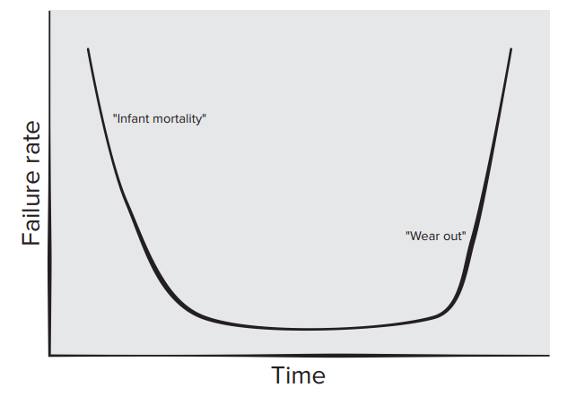
Failure curve for hardware
Figure depicts failure rate as a function of time for hardware.
The relationship, often called the “bathtub curve,” indicates that hardware exhibits relatively high failure rates early in its life (these failures are often attributable to design or manufacturing defects); defects are corrected, and the failure rate drops to a steady-state level (hopefully, quite low) for some period of time.
As time passes, however, the failure rate rises again as hardware components suffer from the cumulative effects of dust, vibration, abuse, temperature extremes, and many other environmental maladies.

Slide 32
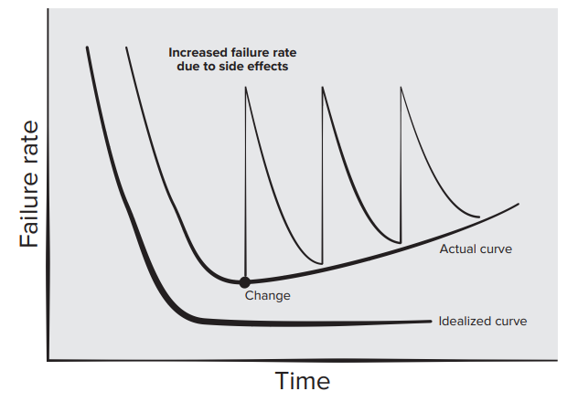
Failure curve for software
The failure rate curve for software should take the form of the “idealized curve” shown in Figure.
Undiscovered defects will cause high failure rates early in the life of a program. However, these are corrected and the curve flattens as shown.
The idealized curve is a gross oversimplification of actual failure models for software. However, the implication is clear—software doesn’t wear out. But it does deteriorate!

Slide 33
Software Application Domains
System software. A collection of programs written to service other programs.
Application software. Stand-alone programs that solve a specific business need.
Engineering/scientific software. A broad array of “number-crunching” or data science programs that range from astronomy to volcanology, from automotive stress analysis to orbital dynamics, from computer-aided design to consumer spending habits, and from genetic analysis to meteorology.
Embedded software. Resides within a product or system and is used to implement and control features and functions for the end user and for the system itself.

Slide 34
Software Application Domains
Product-line software. Composed of reusable components and designed to provide specific capabilities for use by many different customers.
Web/mobile applications. This network-centric software category spans a wide array of applications and encompasses browser-based apps, cloud computing, service-based computing, and software that resides on mobile devices.
Artificial intelligence software. Makes use of heuristics to solve complex problems that are not amenable to regular computation or straightforward analysis. Applications within this area include robotics, decision-making systems, pattern recognition (image and voice), machine learning, theorem proving, and game playing.

Slide 35
Legacy software
Legacy software systems . . . were developed decades ago and have been continually modified to meet changes in business requirements and computing platforms. The proliferation of such systems is causing headaches for large organizations who find them costly to maintain and risky to evolve.
If the legacy software meets the needs of its users and runs reliably, it isn’t broken and does not need to be fixed.
Legacy systems sometimes have inextensible designs, convoluted code, poor or nonexistent documentation, test cases and results that were never archived, and a poorly managed change history

Slide 36
Legacy software
Legacy systems often evolve for one or more of the following reasons:
The software must be adapted to meet the needs of new computing environments or technology.
The software must be enhanced to implement new business requirements.
The software must be extended to make it work with other more modern systems or databases.
The software must be re-architected to make it viable within an evolving computing environment.

Slide 37

Software engineering layers
The bedrock that supports software engineering is a quality focus
The foundation for software engineering is the process layer. The software engineering process is the glue that holds the technology layers together and forms the basis for management control of the software projects and establishes the context in which technical methods are applied.
Software engineering methods provide the technical how-to’s for building software. Methods encompass a broad array of tasks that include communication, requirements analysis, design modeling, program construction, testing, and support
Software engineering tools provide automated or semi-automated support for the process and the methods.

Slide 38
The Software Process
A process is a collection of activities, actions, and tasks that are performed when some work product is to be created.
An activity strives to achieve a broad objective (e.g., communication with stakeholders) and is applied regardless of the application domain, size of the project, complexity of the effort, or degree of rigor with which software engineering is to be applied.
An action (e.g., architectural design) encompasses a set of tasks that produce a major work product (e.g., an architectural model).
A task focuses on a small, but well-defined objective (e.g., conducting a unit test) that produces a tangible outcome.

Slide 39
The Process Framework
The process framework encompasses a set of umbrella activities that are applicable across the entire software process. A generic process framework for software engineering encompasses five activities:
Communication. Before any technical work can commence, it is critically important to communicate and collaborate with the customer (and other stakeholders).
Planning. A software project plan— defines the software engineering work by describing the technical tasks to be conducted, the risks that are likely, the resources that will be required, the work products to be produced, and a work schedule
Modelling. A software engineer does the same thing by creating models to better understand software requirements and the design that will achieve those requirements.
Construction. What you design must be built. This activity combines code generation (either manual or automated) and the testing that is required to uncover errors in the code.
Deployment. The software (as a complete entity or as a partially completed increment) is delivered to the customer who evaluates the delivered product and provides feedback based on the evaluation.

Slide 40
Umbrella Activities
Software project tracking and control. Allows the software team to assess progress against the project plan and take any necessary action to maintain the schedule.
Risk management. Assesses risks that may affect the outcome of the project or the quality of the product.
Software quality assurance. Defines and conducts the activities required to ensure software quality.
Technical reviews. Assess software engineering work products in an effort to uncover and remove errors before they are propagated to the next activity.

Slide 41
Umbrella Activities
Measurement. Defines and collects process, project, and product measures that assist the team in delivering software that meets stakeholders’ needs; can be used in conjunction with all other framework and umbrella activities.
Software configuration management. Manages the effects of change throughout the software process.
Reusability management. Defines criteria for work product reuse (including software components) and establishes mechanisms to achieve reusable components.
Work product preparation and production. Encompasses the activities required to create work products such as models, documents, logs, forms, and lists.

Slide 42
Software Engineering Practice
The essence of software engineering practice:
Understand the problem (communication and analysis).
Plan a solution (modeling and software design).
Carry out the plan (code generation).
Examine the result for accuracy (testing and quality assurance)

Slide 43
The First Principle: The Reason It All Exists
A software system exists for one reason: to provide value to its users.
All decisions should be made with this in mind.
Before specifying a system requirement, before noting a piece of system functionality, before determining the hardware platforms or development processes, ask yourself questions such as:
“Does this add real value to the system?”
If the answer is no, don’t do it. All other principles support this one

Slide 44
The Second Principle: KISS (Keep It Simple, Stupid!)
There are many factors to consider in any design effort. All design should be as simple as possible, but no simpler. This facilitates having a more easily understood and easily maintained system.

Slide 45
The Third Principle: Maintain the Vision
A clear vision is essential to the success of a software project. Without conceptual integrity, a system threatens to become a patchwork of incompatible designs, held together by the wrong kind of screws . . .
Compromising the architectural vision of a software system weakens and will eventually break even the well-designed systems.

Slide 46
The Fourth Principle: What You Produce, Others Will Consume
Always specify, design, document, and implement knowing someone else will have to understand what you are doing.
The audience for any product of software development is potentially large. Specify with an eye to the users.
Design, keeping the implementers in mind.
Code with concern for those that must maintain and extend the system. Someone may have to debug the code you write, and that makes them a user of your code.
Making their job easier adds value to the system.

Slide 47
The Fifth Principle: Be Open to the Future
In today’s computing environments, where specifications change on a moment’s notice and hardware platforms are obsolete just a few months old, software lifetimes are typically measured in months instead of years.
However, true “industrial strength” software systems must endure far longer.
To do this, systems must be ready to adapt to these and other changes.
Systems that do this successfully have been designed this way from the start. Never design yourself into a corner

Slide 48
The Sixth Principle: Plan Ahead for Reuse
Reuse saves time and effort.
Achieving a high level of reuse is arguably the hardest goal to accomplish in developing a software system.
The reuse of code and designs has been proclaimed as a major benefit of using object-oriented technologies.
However, the return on this investment is not automatic.
Planning ahead for reuse reduces the cost and increases the value of both the reusable components and the systems into which they are incorporated.

Slide 49
The Seventh Principle: Think!
This last principle is probably the most overlooked. Placing clear, complete thought before action almost always produces better results.
When you think about something, you are more likely to do it right. You also gain knowledge about how to do it right again.
If you do think about something and still do it wrong, it becomes a valuable experience. A side effect of thinking is learning to recognize when you don’t know something, at which point you can research the answer.
When clear thought has gone into a system, value comes out.

Slide 50
Class Activity I
List possible stakeholders for a library cataloguing system.
Why is it important to understand the roles of people involved in requirements engineering process?
What are the key questions which must be answered when planning improvements to business process?
Using examples to support your answer, explain why domain knowledge is important in the requirements elicitation process?
Suppose you are a requirement engineer for a train protection system which will automatically bring a train to a halt if it exceeds the speed limit for a track segment or if it goes through a red light. List at least five questions that you would ask when you interview stakeholders for requirements elicitation.

